Slide 1
Introduction to Data Science
John P Dickerson
Midterm Review – 10/17/2019
CMSC320
Tuesdays & Thursdays
5:00pm – 6:15pm

Slide 2
Announcements
Mini-Project #3 is not out yet! Will be out after the midterm.
It will be linked to from ELMS; will also be available at: https://github.com/cmsc320/fall2019/tree/master/project3
Deliverable is a .ipynb file submitted to ELMS
Due before Thanksgiving (TBD)
Please label your ipynb file something like <lastname>_<firstname>_project3.ipynb
E.g., dickerson_john_project3.ipynb

Slide 3
Project 1 Grades are up!
General comments:
People did really well!
We used a fairly strict rubric, but if you have a real bone to pick with your grade, please triage through TAs/office hours!
Comments for our sanity, moving forward:
df.head(n) -- defaults to n = 5, use ~10, 20, 50 as needed
Please label your ipynb file something like <lastname>_<firstname>_project3.ipynb
E.g., dickerson_john_project3.ipynb

Slide 4
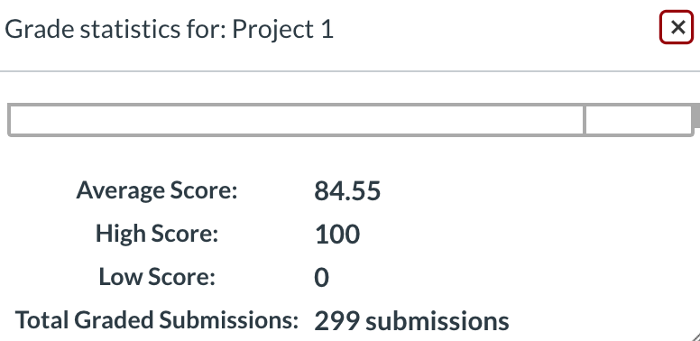
Project 1 Grades are up!

Slide 5
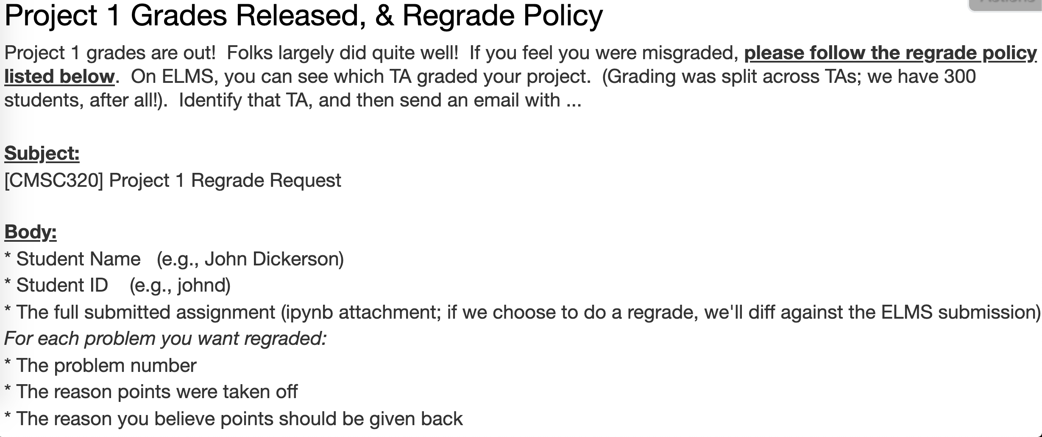
Project 1 Grades are up!

Slide 6

CMSC320

Slide 7
Midterm: Structure
50 points = 25% of the total grade
10 points:
10 True/False questions, 1 point each
10 points:
5 multiple choice questions, 2 points each
30 points:
10 short answer questions, 3 points each
Compared to the CMSC320 midterm I posted from an earlier semester, this midterm is shorter.

Slide 8
Midterm: Cheat Sheet
You can use a cheat sheet on the exam:
Create it on your own
Handwritten notes only
One side of one 8.5x11 inch ("normal-sized”) sheet of paper
You’ll turn in your cheat sheet with your midterm

Slide 9
Quick midterm review
As discussed in previous lectures and on Piazza, the midterm can cover:
Up to and including today’s lecture (10/17)
Quizzes that were due on or before today
Stuff that you should know from doing P1 and P2
Everything is online: https://cmsc320.github.io/
I know this is a lot of material.
Rule of thumb: open up a slide deck
Do you feel “comfortable” with the material?
Test will be more qualitative than prior 1xx, 2xx, 3xx tests

Slide 10
Quick Midterm Review
Data collection
Data processing
Exploratory analysis
&
Data viz
Analysis, hypothesis testing, & ML
Insight & Policy Decision
Not exhaustive! Ask questions!

Slide 11
Data Collection (DC) & Data Processing (DP)
We talked about:
Scraping data
RESTful APIs
Structured data formats (JSON, XML, etc)
Regexes
Data manipulation via Numpy Stack (Numpy, Pandas, etc)
Indexing, slicing, groups, joins, aggregate queries, etc
Tidy data + melting
Version control (just know how this works qualitatively)
RDMS, a little bit of SQL
Entity resolution & other data integration issues
Storing stuff as a graph, and manipulating it

Slide 12
DC: HTTP Requests
https://www.google.com/?q=cmsc320&tbs=qdr:m
HTTP GET Request:
GET /?q=cmsc320&tbs=qdr:m HTTP/1.1 Host: www.google.com User-Agent: Mozilla/5.0 (X11; Linux x86_64; rv:10.0.1) Gecko/20100101 Firefox/10.0.1
??????????
params = { “q”: “cmsc320”, “tbs”: “qdr:m” }
r = requests.get( “https://www.google.com”, params = params )
*be careful with https:// calls; requests will not verify SSL by default

Slide 13
DC: Restful APIs
This class will just query web APIs, but full web APIs typically allow more.
Representational State Transfer (RESTful) APIs:
GET: perform query, return data
POST: create a new entry or object
PUT: update an existing entry or object
DELETE: delete an existing entry or object
Can be more intricate, but verbs (“put”) align with actions

Slide 14
DC: Pandas: series
Subclass of numpy.ndarray
Data: any type
Index labels need not be ordered
Duplicates possible but result in reduced functionality

Slide 15
DC: Pandas: DataFrame
Each column can have a different type
Row and Column index
Mutable size: insert and delete columns
Note the use of word “index” for what we called “key”
Relational databases use “index” to mean something else
Non-unique index values allowed
May raise an exception for some operations

Slide 16
DC: Storing a Graph
Three main ways to represent a graph in memory:
Adjacency lists
Adjacency dictionaries
Adjacency matrix
The storage decision should be made based on the expected use case of your graph:
Static analysis only?
Frequent updates to the structure?
Frequent updates to semantic information?

Slide 17
DC: Adjacency Lists
For each vertex, store an array of the vertices it connects to
Pros: ????????
Iterate over all outgoing edges; easy to add an edge
Cons: ????????
Checking for the existence of an edge is O(|V|), deleting is hard
A
C
Vertex | Neighbors
A | [C]
B | [C, D]
C | [A]
D | []
B
D

Slide 18
DC: Adjacency Dictionaries
For each vertex, store a dictionary of vertices it connects to
Pros: ?????????
O(1) to add, remove, query edges
Cons: ?????????
Overhead (memory, caching, etc)
A
C
Vertex | Neighbors
A | {C: 1.0}
B | {C: 1.0, D: 1.0}
C | {A: 1.0}
D | {}
B
D

Slide 19
DC: Adjacency Matrix
Store the connectivity of the graph in a matrix
Cons: ?????????
O(|V|²) space regardless of the number of edges
Almost always stored as a sparse matrix
From
A
C
 | A | B | C | D
A | 0 | 0 | 1 | 0
B | 0 | 0 | 0 | 0
C | 1 | 1 | 0 | 0
D | 0 | 1 | 0 | 0
To
B
D

Slide 20
DP: Select/slicing
Select only some of the rows, or some of the columns, or a combination
ID | age
1 | 12.2
2 | 11.0
3 | 15.6
4 | 35.1
ID | age | wgt_kg | hgt_cm
1 | 12.2 | 42.3 | 145.1
2 | 11.0 | 40.8 | 143.8
3 | 15.6 | 65.3 | 165.3
4 | 35.1 | 84.2 | 185.8
Only columns
ID and Age
Both
Only rows with wgt > 41
ID | age
1 | 12.2
3 | 15.6
4 | 35.1
ID | age | wgt_kg | hgt_cm
1 | 12.2 | 42.3 | 145.1
3 | 15.6 | 65.3 | 165.3
4 | 35.1 | 84.2 | 185.8

Slide 21
DP: Aggregate/Reduce
Combine values across a column into a single value
73.9 | 232.6 | 640.0
ID | age | wgt_kg | hgt_cm
1 | 12.2 | 42.3 | 145.1
2 | 11.0 | 40.8 | 143.8
3 | 15.6 | 65.3 | 165.3
4 | 35.1 | 84.2 | 185.8
SUM
MAX
35.1 | 84.2 | 185.8
SUM(wgt_kg^2 - hgt_cm)
What about ID/Index column?
Usually not meaningful to aggregate across it
May need to explicitly add an ID column
14167.66

Slide 22
DP: Map
Apply a function to every row, possibly creating more or fewer columns
ID | Address
1 | College Park, MD, 20742
2 | Washington, DC, 20001
3 | Silver Spring, MD 20901
ID | City | State | Zipcode
1 | College Park | MD | 20742
2 | Washington | DC | 20001
3 | Silver Spring | MD | 20901
Variations that allow one row to generate multiple rows in the output (sometimes called “flatmap”)

Slide 23
DP: Group By
A = foo
Group tuples together by column/dimension
ID | B | C
1 | 3 | 6.6
3 | 4 | 3.1
4 | 3 | 8.0
7 | 4 | 2.3
8 | 3 | 8.0
ID | A | B | C
1 | foo | 3 | 6.6
2 | bar | 2 | 4.7
3 | foo | 4 | 3.1
4 | foo | 3 | 8.0
5 | bar | 1 | 1.2
6 | bar | 2 | 2.5
7 | foo | 4 | 2.3
8 | foo | 3 | 8.0
By ‘A’
A = bar
ID | B | C
2 | 2 | 4.7
5 | 1 | 1.2
6 | 2 | 2.5

Slide 24
DP: Group By
B = 1
ID | A | C
5 | bar | 1.2
Group tuples together by column/dimension
B = 2
ID | A | C
2 | bar | 4.7
6 | bar | 2.5
ID | A | B | C
1 | foo | 3 | 6.6
2 | bar | 2 | 4.7
3 | foo | 4 | 3.1
4 | foo | 3 | 8.0
5 | bar | 1 | 1.2
6 | bar | 2 | 2.5
7 | foo | 4 | 2.3
8 | foo | 3 | 8.0
B = 3
By ‘B’
ID | A | C
1 | foo | 6.6
4 | foo | 8.0
8 | foo | 8.0
B = 4
ID | A | C
3 | foo | 3.1
7 | foo | 2.3

Slide 25
DP: Group By
A = bar, B = 1
ID | C
5 | 1.2
Group tuples together by column/dimension
A = bar, B = 2
ID | C
2 | 4.7
6 | 2.5
ID | A | B | C
1 | foo | 3 | 6.6
2 | bar | 2 | 4.7
3 | foo | 4 | 3.1
4 | foo | 3 | 8.0
5 | bar | 1 | 1.2
6 | bar | 2 | 2.5
7 | foo | 4 | 2.3
8 | foo | 3 | 8.0
A = foo, B = 3
By ‘A’, ‘B’
ID | C
1 | 6.6
4 | 8.0
8 | 8.0
A = foo, B = 4
ID | C
3 | 3.1
7 | 2.3

Slide 26
DP: Group By Aggregate
B = 1
B = 1
ID | A | C
5 | bar | 1.2
Sum (C)
1.2
B = 2
Compute one aggregate
Per group
ID | A | C
2 | bar | 4.7
6 | bar | 2.5
B = 2
Sum (C)
7.2
ID | A | B | C
1 | foo | 3 | 6.6
2 | bar | 2 | 4.7
3 | foo | 4 | 3.1
4 | foo | 3 | 8.0
5 | bar | 1 | 1.2
6 | bar | 2 | 2.5
7 | foo | 4 | 2.3
8 | foo | 3 | 8.0
B = 3
B = 3
ID | A | C
1 | foo | 6.6
4 | foo | 8.0
8 | foo | 8.0
Group by ‘B’
Sum on C
Sum (C)
22.6
B = 4
B = 4
Sum (C)
5.4
ID | A | C
3 | foo | 3.1
7 | foo | 2.3
26

Slide 27
DP: Group By Aggregate
B = 1
Sum (C)
1.2
Final result usually seen
As a table
B = 2
Sum (C)
7.2
ID | A | B | C
1 | foo | 3 | 6.6
2 | bar | 2 | 4.7
3 | foo | 4 | 3.1
4 | foo | 3 | 8.0
5 | bar | 1 | 1.2
6 | bar | 2 | 2.5
7 | foo | 4 | 2.3
8 | foo | 3 | 8.0
B | SUM(C )
1 | 1.2
2 | 7.2
3 | 22.6
4 | 5.4
B = 3
Group by ‘B’
Sum on C
Sum (C)
22.6
B = 4
Sum (C)
5.4
27

Slide 28
DP: Union/Intersection/Difference
Set operations – only if the two tables have identical attributes/columns
ID | A | B | C
1 | foo | 3 | 6.6
2 | bar | 2 | 4.7
3 | foo | 4 | 3.1
4 | foo | 3 | 8.0
5 | bar | 1 | 1.2
6 | bar | 2 | 2.5
7 | foo | 4 | 2.3
8 | foo | 3 | 8.0
ID | A | B | C
1 | foo | 3 | 6.6
2 | bar | 2 | 4.7
3 | foo | 4 | 3.1
4 | foo | 3 | 8.0
ID | A | B | C
5 | bar | 1 | 1.2
6 | bar | 2 | 2.5
7 | foo | 4 | 2.3
8 | foo | 3 | 8.0
U
Similarly Intersection and Set Difference manipulate tables as Sets
IDs may be treated in different ways, resulting in somewhat different behaviors
28

Slide 29
DP: Merge or Join
Combine rows/tuples across two tables if they have the same key
ID | A | B
1 | foo | 3
2 | bar | 2
3 | foo | 4
4 | foo | 3
ID | C
1 | 1.2
2 | 2.5
3 | 2.3
5 | 8.0
ID | A | B | C
1 | foo | 3 | 1.2
2 | bar | 2 | 2.5
3 | foo | 4 | 2.3
⨝
What about IDs not present in both tables?
Often need to keep them around
Can “pad” with NaN
29

Slide 30
DP: Merge or Join
Combine rows/tuples across two tables if they have the same key
Outer joins can be used to ”pad” IDs that don’t appear in both tables
Three variants: LEFT, RIGHT, FULL
SQL Terminology -- Pandas has these operations as well
ID | A | B
1 | foo | 3
2 | bar | 2
3 | foo | 4
4 | foo | 3
ID | C
1 | 1.2
2 | 2.5
3 | 2.3
5 | 8.0
ID | A | B | C
1 | foo | 3 | 1.2
2 | bar | 2 | 2.5
3 | foo | 4 | 2.3
4 | foo | 3 | NaN
5 | NaN | NaN | 8.0
⟗
30

Slide 31
DP: Google Image Search One Slide SQL Join Visual
Image credit: http://www.dofactory.com/sql/join

Slide 32
DC/DP: How a relational DB fits into your workflow
Persists!
Raw Input
Python
SQLite File
SQL
SQL
Structured output (trained classifiers, JSON for D3, visualizations)
SQLite CLI & GUI Frontend
Persists!

Slide 33
DP: Additional stuff
Data integration
Extraction, schema alignment & mapping, querying over multiple schema / global schema
Data quality issues
Single- vs multi-source quality issues
Data cleaning
Outlier detection, constraint-based cleaning
Entity resolution (~part of data cleaning)
Deduplication, record linkage, reference matching
Fuzzy matching, etc.

Slide 34
EDA & Viz
Missing data
MCAR
MAR
MNAR
Single & multiple imputation
Analysis
Basic linear regression
Summary statistics / robust statistics
Variance, stdev, covariance, Pearson’s correlation coefficient
Hypothesis testing
Bayes’ rule

Slide 35
EDA: Missing Data
Missing data is information that we want to know, but don’t
It can come in many forms, e.g.:
People not answering questions on surveys
Inaccurate recordings of the height of plants that need to be discarded
Canceled runs in a driving experiment due to rain
Could also consider missing columns (no collection at all) to be missing data …
[JA]

Slide 36
EDA: Complete Case Analysis
Delete all tuples with any missing values at all, so you are left only with observations with all variables observed
Default behavior for libraries for analysis (e.g., regression)
We’ll talk about this much more during the Stats/ML lectures
This is the simplest way to handle missing data. In some cases, will work fine; in others, ?????????????:
Loss of sample will lead to variance larger than reflected by the size of your data
May bias your sample
# Clean out rows with nil values
df = df.dropna()
[JA]

Slide 37
EDA: Your Sample
Hair Color | Gender | Grade
Red | M | A
Brown | F | A
Black | F | B
Black | M | A
Brown | M
Brown | M
Brown | F
Black | M | B
Black | M | B
Brown | F | A
Black | F
Brown | F | C
Red | M
Red | F | A
Brown | M | A
Black | M | A
Summary:
7 students received As
3 students received Bs
1 student received a C
Nobody is failing!
But 5 students did not reveal their grade …
[JA]

Slide 38
EDA: What influences a data point’s Presence?
Same dataset, but the values are replaced with a “0” if the data point is observed and “1” if it is not
Question: for any one of these data points, what is the probability that the point is equal to “1” …?
What type of missing-ness do the grades exhibit?
Hair Color | Gender | Grade
0 | 0 | 0
0 | 0 | 0
0 | 0 | 0
0 | 0 | 0
0 | 0 | 1
0 | 0 | 1
0 | 0 | 1
0 | 0 | 0
0 | 0 | 0
0 | 0 | 0
0 | 0 | 1
0 | 0 | 0
0 | 0 | 1
0 | 0 | 0
0 | 0 | 0
0 | 0 | 0
[JA]

Slide 39
EDA: MCAR: Missing Completely at Random
If this probability is not dependent on any of the data, observed or unobserved, then the data is Missing Completely at Random (MCAR)
Suppose that X is the observed data and Y is the unobserved data. Call our “missing matrix” R
Then, if the data are MCAR, P(R|X,Y) = ??????????
P(R|X,Y) = P(R)
Probability of those rows missing is independent of anything.
[JA]

Slide 40
EDA: MAR: Missing at Random
Missing at Random (MAR): probability of missing data is dependent on the observed data but not the unobserved data
Suppose that X is the observed data and Y is the unobserved data. Call our “missing matrix” R
Then, if the data are MAR, P(R|X,Y) = ??????????
P(R|X,Y) = P(R|X)
Not exactly random (in the vernacular sense).
There is a probabilistic mechanism that is associated with whether the data is missing
Mechanism takes the observed data as input

Slide 41
EDA: MNAR: Missing Not at Random
MNAR: missing-ness has something to do with the missing data itself
Examples: ??????????
Do you binge drink? Do you have a trust fund? Do you use illegal drugs? What is your sexuality? Are you depressed?
Said to be “non-ignorable”:
Missing data mechanism must be considered as you deal with the missing data
Must include model for why the data are missing, and best guesses as to what the data might be

Slide 42
EDA: Back to CSIC …
Is the the missing data:
MCAR;
MAR; or
MNAR?
???????????
Hair Color | Gender | Grade
Red | M | A
Brown | F | A
Black | F | B
Black | M | A
Brown | M
Brown | M
Brown | F
Black | M | B
Black | M | B
Brown | F | A
Black | F
Brown | F | C
Red | M
Red | F | A
Brown | M | A
Black | M | A

Slide 43
EDA: Add a variable
Bring in the GPA:
Does this change anything?
Hair Color | GPA | Gender | Grade
Red | 3.4 | M | A
Brown | 3.6 | F | A
Black | 3.7 | F | B
Black | 3.9 | M | A
Brown | 2.5 | M
Brown | 3.2 | M
Brown | 3.0 | F
Black | 2.9 | M | B
Black | 3.3 | M | B
Brown | 4.0 | F | A
Black | 3.65 | F
Brown | 3.4 | F | C
Red | 2.2 | M
Red | 3.8 | F | A
Brown | 3.8 | M | A
Black | 3.67 | M | A

Slide 44
EDA: Multiple Imputation Process
s₁
a₁
Incomplete data
s₂
a₂
Pooled results
s_{N}
a_{N}
Impute N times
Analysis performed on each imputed set

Slide 45
Analysis: Importance of vertices
Not all vertices are equally important
Centrality Analysis:
Find out the most important node(s) in one network
Used as a feature in classification, for visualization, etc …
Commonly-used Measures
Degree Centrality
Closeness Centrality
Betweenness Centrality
Eigenvector Centrality

Slide 46
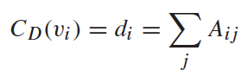
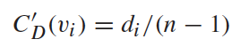
Analysis: Degree Centrality
The importance of a vertex is determined by the number of vertices adjacent to it
The larger the degree, the more important the vertex is
Only a small number of vertex have high degrees in many real-life networks
Degree Centrality:
Normalized Degree Centrality:
For vertex 1, degree centrality is 3;
Normalized degree centrality is
3/(9-1)=3/8.
Notes:
“A small number of nodes have high degrees” thanks to the power law

Slide 47
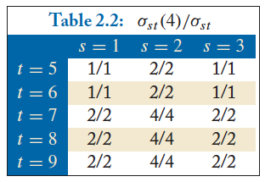
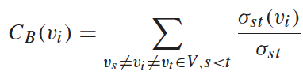
Analysis: Betweenness CentralitY
The number of shortest paths between s and t
The number of shortest paths between s and t that pass v_{i}
What is the betweenness centrality for node 4 ?????????

Slide 48
Analysis: Term Frequency
Term frequency: the number of times a term appears in a specific document
tf_{ij}: frequency of word j in document i
This can be the raw count (like in the BOW in the last slide):
tf_{ij} ∈ {0,1} if word j appears or doesn’t appear in doc i
log(1 + tf_{ij}) – reduce the effect of outliers
tf_{ij} / max_{j} tf_{ij} – normalize by document i’s most frequent word
What can we do with this?
Use as features to learn a classifier w → y …!

Slide 49
Analysis: Inverse Document Frequency
Recall:
tf_{ij}: frequency of word j in document i
Any issues with this ??????????
Term frequency gets overloaded by common words
Inverse Document Frequency (IDF): weight individual words negatively by how frequently they appear in the corpus:
IDF is just defined for a word j, not word/document pair j, i

Slide 50
Analysis: TF-IDF
How do we use the IDF weights?
Term frequency inverse document frequency (TF-IDF):
TF-IDF score: tf_{ij} x idf_{j}
This ends up working better than raw scores for classification and for computing similarity between documents.
the | CMSC320 | you | he | I | quick | dog | me | CMSCs | … | than
0.8 | 0 | 0 | 0 | 0 | 1.1 | 1.1 | 0 | 0 | … | 0
0 | 0 | 2.2 | 0.8 | 1.1 | 0 | 0 | 1.1 | 0 |  | 0
0.8 | 1.1 | 0 | 0.4 | 0 | 0 | 0 | 0 | 1.1 |  | 1.1
Document 1
Document 2
Document 3

Slide 51
Analysis: Similarity between Documents
Given two documents x and y, represented by their TF-IDF vectors (or any vectors), the cosine similarity is:
Formally, it measures the cosine of the angle between two vectors x and y:
cos(0º) = 1, cos(90º) = 0 ??????????
Similar documents have high cosine similarity; dissimilar documents have low cosine similarity.

Slide 52
One last thing …
Bring a writing utensil. You will need to it. To write.

